Slide 1
CAF Expert Learning Path Hackathon - Basic

Slide 2
CAF Basic
Hackathon
Target roles:
Techn. Sales
Consultants
Architects
Hackathon Description
This CAF Hackathon enables attendees to understand and get familiar on how the Microsoft Cloud Adoption Framework for Azure (CAF) can be applied with their customers. This hackathon walks through the Define Strategy and Plan phases of the CAF to support attendees in leading a client engagement that is considering moving their digital assets to Azure.
By the end of the CAF Hackathon, attendees will have built a cloud adoption plan that they can use to present to a customer’s C-Suite to justify adopting the cloud. The purpose of this exercise is to provide you with the tools and understanding that will complement the conversations attendees may be having with their customers.
Challenge 1 - Strategy
Document motivations and benefits for moving to the cloud.
Establish clear business outcomes, by key stakeholders or decision-makers, that align with your motivations.
Define your business case by capturing a business justification through a financial model to project business impact.
Challenge 2 - Governance
High-level governance structure
Skills readiness path; capabilities required for managing their cloud environment
Cloud adoption team verified (RACI)
Azure Services and related products
Cloud Adoption Framework
Azure Migrate
Challenge 3 - Building the Plan
Take inventory of your digital estate
Understanding cloud costs
Prerequisites
Azure Knowledge (compared to AZ-900)
Azure Subscription with owner rights
Challenge 4 - Presenting the plan to the customer

Slide 3
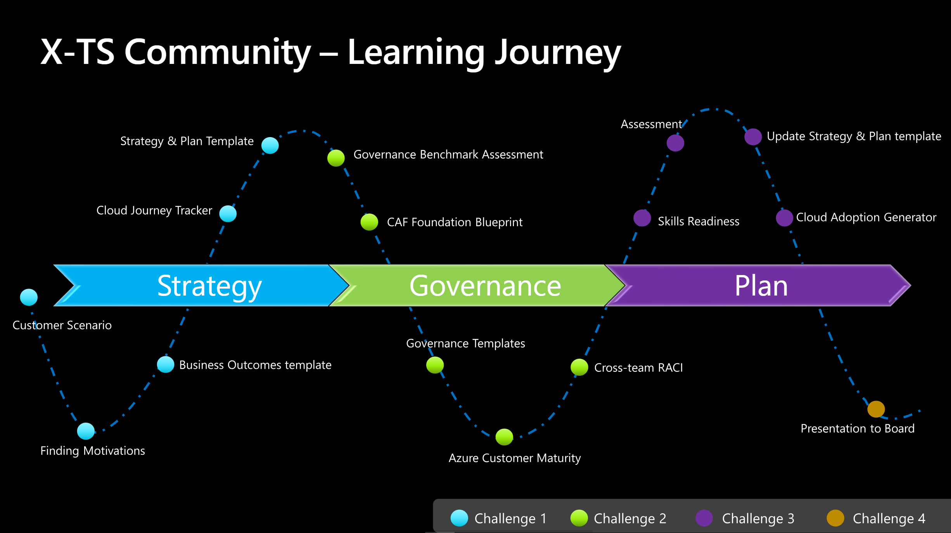
Our Journey today…

Slide 4
Agenda
DAY 1
0900 - 0930 | Intro
0930 - 1130 | Challenge 1 - Strategy
1130 - 1140 | Break
1140 - 1300 | Challenge 2 - Governance
1300 - 1330 | Lunch Break
1330 - 1430 | Challenge 3 - Plan
1430 - 1440 | Break
1510 – 1730 | Challenge 4 – Present to CxO

Slide 5

Cloud Adoption Framework for Azure | Overview
Notes:
Welcome slide

Slide 6
Achieve balance. Deliver modernization. Deli
Best practices
Templates
People
Process
Technology
Documentation
Tools
Control & Stability
Speed &
Results
Align—business, people and technology strategy.
Achieve—business goals with actionable, efficient, and comprehensive guidance.
Deliver—fast results with control and stability.
Notes:
<Key point>: Change is more than adopting technology. It’s adapting how you do business.
The Microsoft Cloud Adoption Framework for Azure means changing how you do business—not just swapping out technology, but changing your enterprise, the culture behind it, and you too.
We share best practices from our employees, partners, and customers who have already undertaken the cloud journey.
The Cloud Adoption Framework brings together people, process, and technology—a strategy that’s aligned to your business goals.
Quickly—efficiently, and with actionable guidance, it provides guidance for your organization’s agile business transformation.
Leading people through change is difficult. It’s not just the technology that changes. It’s your people and processes too.
We can help guide you through.
<Transition>: How does the Cloud Adoption Framework work for your business?

Slide 7
Cloud adoption is more than just technologie
Change requires radical thinking.
… but change is difficult.
We understand that.
Change impacts your people, your culture, and feels risky.
It requires leaders to adapt, take risks, and learn quickly.
Change requires a culture shift
within your organization,
and starts with you.
Notes:
<Key point>: change is hard—because it affects people, not just process.
The decision to commit to change is only the first step.
Whether evolving to meet increased market demand, or face tough foreign competition, change is inevitable.
Many business leaders already realize that change is much more than just swapping out technologies.
It’s an incremental process—evolving in how you’re doing business that affects culture company-wide—all your employees. And it starts with you, the business leader.
You know that the journey to the cloud is hard, but necessary to continue to grow in an evolving marketplace.
<Transition>: For businesses, it’s step-by-step path to modernization—and growth.

Slide 8
CAF as a iterative process
Plan
An iterative process that supports your business … as it evolves
Govern
Manage
Define strategy
Adopt
Ready
Notes:
<Key point>: An iterative process that supports your business needs.
We can help you on your cloud adoption journey.
We put the experience of employees, partners, and customers to work for you.
We work together with you—to build your plan for cloud adoption.
It starts with your vision.
Crystallize your vision for cloud adoption by working cross-functionally with your finance, marketing, sales, and HR departments.
Work to gain consensus on:
Clear motivations: Why are we adopting the cloud?
Defined business outcomes: What results do we expect to see from adopting the cloud?
Business justification: How will the business measure success?
We work with you to build an actionable cloud adoption plan with strategic (above) and tactical inputs such as defining your workloads and assets, aligning your organization, and readying necessary skills.
This cross-team effort is balanced out by the technical team, who will take this vision and execute technical deployment.
We recommend iterative planning to drive your cloud adoption effort—enabling your technical teams to move incrementally, in phases towards cloud adoption.
<move to the Ready phase to explain another example, to show iterative process, if necessary>
You plan will unite your organization in a cross-team initiative that, together, will forecast, budget, implement, and manage its success.
Our approach is Agile, and we consider security, governance, cost-optimization, and hybrid-cloud awareness by default.
Microsoft will work with you, learning how you do business—and help you adapt.
Your organization is changing—moving towards modernization, with challenging new markets, products, customer engagement.
We can help you get there.
<Transition>: What does a cloud adoption framework look like?

Slide 9
Microsoft Cloud Adoption Framework for Azure
Proven guidance to accelerate your cloud adoption journey
Define strategy
Define business justification and expected outcomes
Plan
Align actionable cloud adoption plan to business outcomes
Ready
Prepare people, process and environment for change
Adopt
Migrate or Innovate
Implement desired changes across IT and business processes
Govern
Comply, control and secure
Manage
Operate and optimize
https://aka.ms/adopt/overview
Notes:
<Key point>: Cloud Adoption Framework—modular phases of adoption.
As your organization evolves, the Cloud Adoption Framework adapts to your business needs.
Each module in the diagram is an iterative phase that advances your business through the complete lifecycle of cloud adoption.
Customers can choose the phase best-suited to their degree of cloud adoption maturity. The Cloud Adoption Framework offers a guiding methodology to cloud adoption, with specific approaches to overcoming common blockers to cloud adoption in each module, such as “Define Strategy,” “Plan,”, etc.
The Cloud Adoption Framework offers the enterprise a modular framework of how to incrementally onboard to the cloud.
Cloud adoption shifts how companies obtain, make use of, and lock down their technology resources.
And—this kind of modular framework flips the model of how enterprises operate:
Transitions organizations to need-based consumption of technology resources
Change from cap-ex (capital expenditure) to op-ex (operating expenditure) model
Cloud model assumes security, governance, cost-optimization, and hybrid cloud by default
Develop a future-ready workforce—developing and deploying cloud skill readiness organization-wide
As an organization progresses through the Cloud Adoption Framework, what are the main goals of each methodology of “Define Strategy,” “Plan,” you can focus efforts on?
<Transition>: Let’s look at some possible motivations for cloud adoption, and what some common blockers are that the Cloud Adoption Framework can help you resolve.

Slide 10
Common motivations and scenarios

Slide 11
Cloud Adoption Motivations
Engage stakeholders across business and technology to understand your motivations for cloud adoption
Migration Motivations
Cost Savings
Reduction in vendor or technical complexity
Optimization of internal operations
Increase business agility
Prepare for new technical capabilities
Scale to meet market demands
Scale to meet geographic demands
Critical Business Events
Data center exit
Mergers, acquisition or divestiture
Reductions in capital expenses
End of support for mission critical technologies
Regulatory compliance, data sovereignty requirements
Reduce disruptions and improve IT stability
Innovation Motivations
Prepare for new technical capabilities
Build new technical capabilities
Scale to meet market demands
Scale to meet geographic demands
Improve customer experiences / engagements
Transform products or services
Disrupt the market with new products or services
Notes:
<Key point>: There is no single, typical cloud adoption motivation in cloud adoption—typically there are more than one.
Cloud adoption is an iterative process. There can be many motivations for why your organization is planning digital transformation.
It’s important to engage cross-functional business groups across the enterprise to explore cloud adoption motivations.
[Go through list of Critical Business Events.
[Read through Migration Motivations and Innovation Motivations]
<Transition>: What are some common scenarios leading to cloud adoption—what do they look like?

Slide 12
Migrate existing workloads
Define Strategy
Plan
Ready
Adopt
1
3
Gather data and analyze assets and workloads
6
Build skills readiness plan
8
Migrate first 10 workloads
Align stakeholders
2
Align partner support
7
Deploy an aligned landing zone
4
Make a business case
5
Create migration plan
Govern
Manage
9
Hand-off production workloads to cloud governance
10
Hand-off production workloads to cloud operations
aka.ms/adopt/getstarted-migrate
Notes:
<Key point>: Here are the iterative steps that enable the customer journey of Accelerate migration.
Step 1: Align stakeholders
Gain agreement on migration motivations.
Capture desired business outcomes and measure them with metrics.
Step 2: Align partner support
Microsoft Partners, services, and programs are available to support your migration journey.
Step 3: Gather data and analyze assets and workloads
Inventory existing systems: Validate the business case by using data about the current state environment.
Incremental rationalization: Perform quantitative analysis of that data and a deep qualitative assessment of the highest priority workloads.
​Step 4: Make a business case
Evaluate the initial high-level return from a potential cloud migration.
Ensure that all stakeholders align on a data driven decision whether overall adoption of the cloud is a wise business decision.
Step 5: Create a migration plan
Cloud adoption plan template: Deploy the basic template.
Workload alignment: Define workloads in the backlog.
Effort alignment: Align assets and workloads in the backlog to clearly define effort for prioritized workloads.
People and time alignment: Establish iteration, velocity (people's time), and releases for migrated workloads.
Step 6: Build a skills readiness plan
Quickly evaluate required and existing skills of the team, to better understand what skill requirements should be addressed.
Step 7: Deploy an aligned landing zone
Choose a landing zone: Find the right approach to deploying a landing zone based on your adoption pattern, then deploy that standardized code base.
Expand your landing zone: Regardless of the starting point, identify gaps in the deployed landing zone to add required components for resource organization, security, governance, compliance, and operations.
Step 8: Migrate your first 10 workloads
(Iterative process—repeated every migration).
Assess workloads: Assess each batch of workloads to evaluate cost, architecture, and deployment tooling.
Deploy workloads: Replicate functionality in the cloud using IaaS, PaaS, cloud-native, or other modernization solutions.
Release workloads: Test, optimize, document, and review. Release by handing off for governance, management, and security.
Step 9: Hand off production workloads to cloud governance
Governance approach: Outline a process for thinking about corporate policy and processes. Then build the disciplines required to deliver on governance across your cloud enterprise adoption efforts.
Initial governance foundation: Understand the Identity Baseline discipline, Security Baseline discipline, and Deployment Acceleration discipline, required to create a governance minimum viable product (MVP) to serve as the foundation for all adoption.
Step 10: Hand off production workloads to cloud operations
Establish a management baseline
Define business commitments
Expand the management baseline
Get specific with advanced operations
​
<Transition>: What if you want to Build new products and services?

Slide 13
Build new products and services
Define Strategy
Plan
Ready
Adopt
1
3
Gather data and analyze assets and workloads
7
Deploy an aligned landing zone
8
Innovate in the cloud
Document the business strategy
2
Evaluate business justification
4
Plan asset migration
Govern
Manage
5
Align governance requirements to adoption plan
6
Define operational needs and business commitments
aka.ms/adopt/getstarted-buildnew
Notes:
​<Key point>: Here are the iterative steps that enable the customer journey of Build new products and services.
Step 1: Document the business strategy
Motivations: Strategic align, seek consensus on motivations for the migration effort. Understanding and categorizing motivations and common themes from various stakeholders across business and IT.
Business outcomes: After motivations are aligned, capture the desired business outcomes, using clear metrics to measure overall transformation.
Building a cloud migration business case: Start to develop a migration business case with clear guidance on formulas and tools to help business justification.
Step 2: Evaluate the business justification
Business justification: Before evaluating opportunities to innovate in the cloud, complete a high-level business justification to establish stakeholder alignment for the overall adoption plan.
Business value consensus: Identify how that innovation can align to and drive business value.
Step 3: Gather data and analyze assets and workloads
Inventory existing systems: Validate the business case by using data about the current state environment.
Incremental rationalization: Perform quantitative analysis of that data and a deep qualitative assessment of the highest priority workloads.
​Step 4: Plan for migration of dependent assets
Cloud adoption plan template: Deploy the basic template.
Workload alignment: Define workloads in the backlog.
Effort alignment: Align assets and workloads in the backlog to clearly define effort for prioritized workloads.
People and time alignment: Establish iteration, velocity, and releases for the workloads.
Step 5: Align governance requirements to your adoption plan
Governance approach: Outline a process for corporate policy and processes. Build the disciplines required to deliver on governance across cloud enterprise efforts.
Define corporate policy: Identify and mitigate business risks.
Step 6: Define operational needs and business commitments
Define business commitments: Create business alignment in cloud management.
Get specific with advanced operations: Go beyond your management baseline and apply design principles and advanced operations. If advanced operations are required to support your operations needs, evaluate the business commitments to determine operational responsibilities for both teams.
Step 7: Step 7: Deploy an aligned landing zone
Choose a landing zone: Deploy a landing zone based on your adoption pattern, then deploy that standardized code base.
Expand your landing zone: Regardless of the starting point, identify gaps in the deployed landing zone to add required components for resource organization, security, governance, compliance, and operations.
Step 8: Innovate in the cloud
Business value consensus: If more than three months have passed since the last business value consensus, or if never completed, Identify how innovation can align to and drive business value.
Azure innovation guide: Use the Azure innovation guide to speed up the deployment of innovative solutions by understanding the tools and processes to help build a minimum viable product (MVP).
Innovation best practices: Combine Azure services to create a toolchain for digital invention.
Feedback loops: Develop improved feedback loops to quickly deliver impactful innovations to your customers.
​
<Transition>: What if you want to Unblock environmental design and configuration?​

Slide 14
Tools, templates, and assessments

Slide 15
Tools, templates, and assessments
Define strategy
Plan
Ready
Adopt
Cloud journey tracker
Business outcome template
Azure DevOps demo generator
Cloud adoption plan template
Azure setup guide
Readiness checklist
Naming and tagging tracking template
Landing zone blueprints
Strategic migration assessment and readiness tool (SMART)
Azure migration guide
Azure innovation guide
Govern
Manage
Governance benchmark
Governance process template
Cost Management process template
Deployment acceleration process template
Identity process template
Resource consistency process template
Security baseline process template
Microsoft Azure Well-Architected Review
Best practices source code
Operations management workbook
aka.ms/adopt/tools-templates
Notes:
<Key point> We have tools, assessments, and other assets to support your cloud adoption journey.
<Transition> Although the tools, templates, and assessments enable you to manage your own journey, not everyone wants to do this alone. Let's talk about the role of Microsoft Partners - and how they can lighten the load.

Slide 16
Customer Story

Slide 17
Must do for every project
Take inventory of your digital estate
Catalogue of the workloads, applications, data sources, virtual machines and other IT assets and evaluate them to determine the best way to host them in the cloud.
Identify business risks and define risk tolerances
Business risks and your risk tolerance.
Governance
Cost management,
Security baseline.
Resource consistency
Identity baseline
Deployment automation.

Slide 18
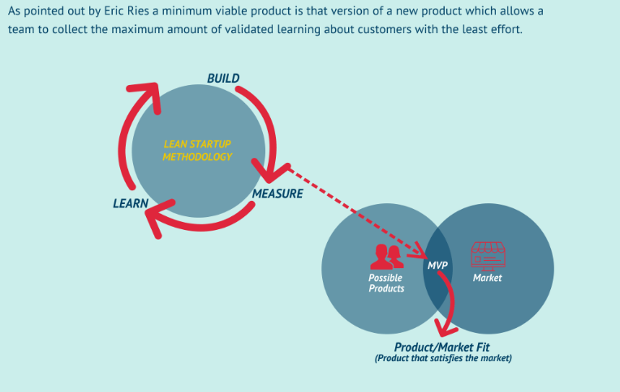
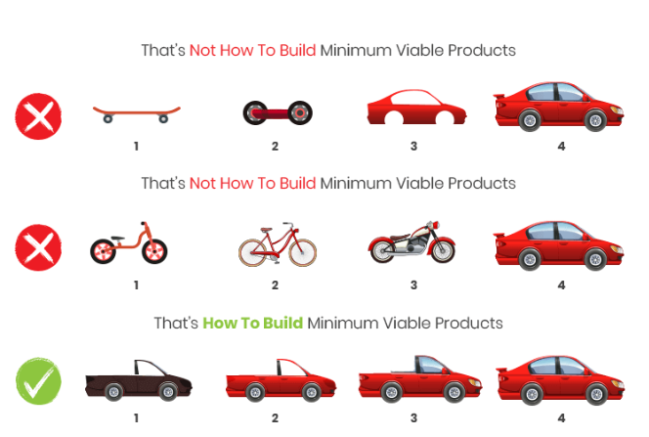
How-to-build a Minimum viable product (MVP)
https://www.starshotsoftware.com/post/best-practices-for-building-a-successful-mvp
Notes:
Transfer – our message to customer

Slide 19
Challenge 1
Define the Strategy

Slide 20
Define strategy
Define strategy
Plan
Ready
Adopt
Documenting the cloud strategy will help business stakeholders and technicians understand the benefits the organization is pursuing by adopting the cloud.
Govern
Manage
Motivations
Executive mandate
DC Exit
Merger and acquisitions
Cost savings
Optimization
Agility
Tech capabilities
Market demands
Geo expansion
Migration
Innovation
Business outcomes
Fiscal: revenue, cost, profit
Agility: timer to market, provisioning,
Reach: global access, sovereignty
Customer engagement: cycle time, from request to release
Performance: SLAs, Downtime, operations, reliability
Business justification
Business case: the cloud is not always cheaper, mirroring is not cloud, servers drive cost analysis
Financial model: Capex/ Opex, ROI, gain, cost avoidance/reduction
Cloud accounting: cost center, procurement, profit center, revenue generating, chargeback
First project
Business criteria: workload supported by a BDM
Technical criteria: minimum dependencies and test path, no governance
Qualitative analysis: Current Team analysis

Slide 21
Challenge 1: Define the Strategy
In this challenge you will learn about the Define Strategy phase from the Cloud Adoption Framework. You will get familiar and understand that there are many reasons and motivations for a cloud adoption and identifying and understanding them is key in developing an effective cloud adoption plan for the customer.
Every customer has different priorities, processes, and organizational structure that need to be evaluated in order to guarantee a successful cloud journey. You will use this information to start designing your business case and the presentation you will be presenting to the customer’s board.
Learning Objectives:
Document motivations and benefits for moving to the cloud.
Establish clear business outcomes, by key stakeholders or decision-makers, that align with your motivations.
Define your business case by capturing a business justification through a financial model to project business impact.

Slide 22
Challenge 2
Governance

Slide 23
Challenge 2: Governance
In this challenge you will have the opportunity to review the organization and understand how they can build a governance framework.
Learning Objectives:
High-level governance structure
Skills readiness path; capabilities required for managing their cloud environment
Cloud adoption team verified (RACI)

Slide 24
Challenge 3
Building the Plan

Slide 25
Plan
Define strategy
Plan
Ready
Adopt
Cloud adoption plans convert the aspirational goals of the cloud adoption strategy into actions. It will help guide technical efforts, in alignment with the business strategy.
Govern
Manage
Digital estate
Rationalization: inventory
Quantitative analysis: asset optimized and sized properly
Qualitative analysis: operational process
Initial organization alignment
Cloud Strategy Team
Business IT: requirements and needs
IT management operations: traditional IT
Governance: executive sponsor, finance, business leadership, legal, security, HR
Cloud platform vendor: account success team
Cost management
IT-business alignment
Governance MVP
Skill readiness plan
Organizational readiness
Governance and security alignment
Initial organization alignment
Building technical skills: business/technical, and certifications
Change management guidance
Cloud adoption plan
5R strategy: rehost, refactor, rearchitect, rebuild, replace
Infrastructure migration: VM, server, database focus
Application innovation: born in the cloud applications, APIs
Data-driven innovation: Focus on data consolidation and analysis

Slide 26
Challenge 3: Building the Plan
This challenge focuses on preparing an assessment of the anticipated cloud costs. You will be provided with a spreadsheet of the customer’s real estate.
Learning Objectives:
Take inventory of your digital estate
Understanding cloud costs
Cloud Adoption Plan

Slide 27
Challenge 4
Presenting the plan to the customer

Slide 28
Challenge 4: Presenting the plan to the customer
This challenge simulates a real-world conversation with your stakeholder’s leadership team. Here, you will present your case and justify why they should adopt Azure.

